Slide 1
Mapping Mashups
Web Mapping APIs
Notes:
Before Start:
- Handout – syllabus
Turn up volume for scream effect
Open blank arcmap

Slide 2
“Mashups”
What is a mashup?
Heterogeneous data and software components combined to create a new application

Slide 3
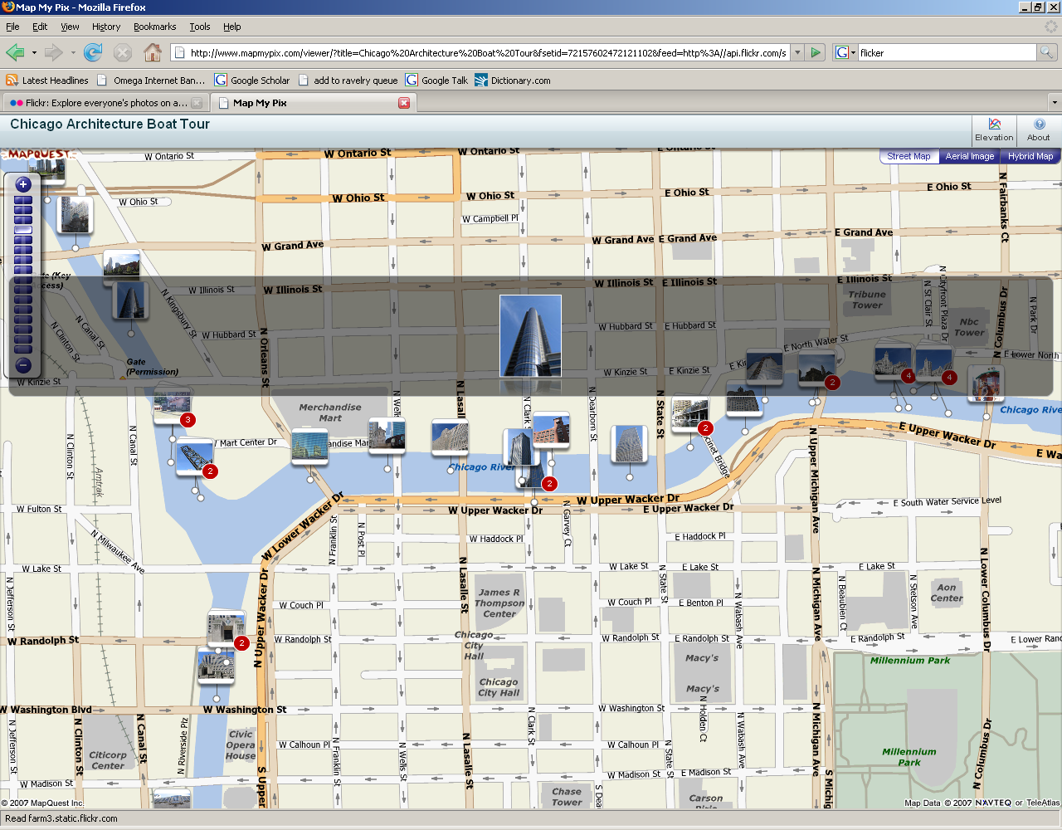
Mashups

Slide 4
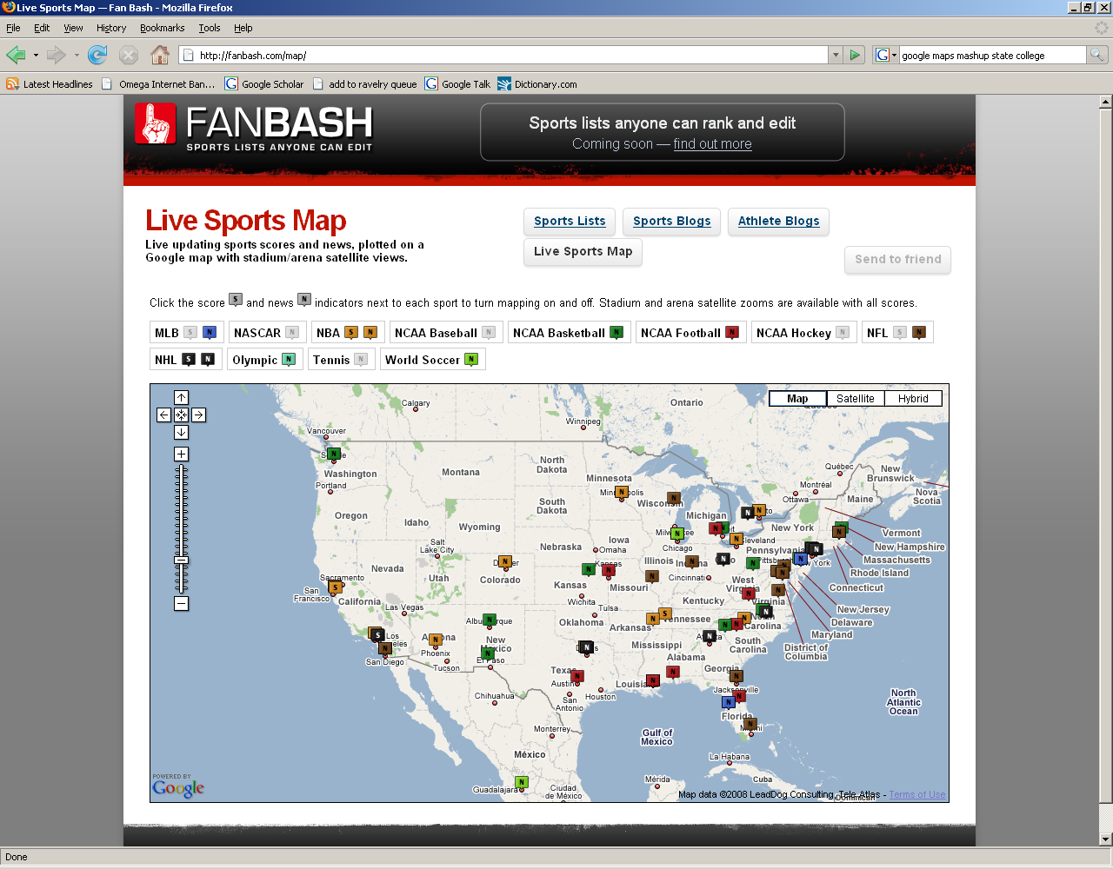
Mapping Mashups
Notes:
Huge boom - anyone not seen google maps?
Mixing content that normally is not together
Most data has a location component
Good example of mapping that can be done by anyone

Slide 5
Mashups
Peruse Examples -
http://googlemapsmania.blogspot.com

Slide 6
Enabling Mashups
Many data/software components easy to incorporate
Some require programming (i.e javascript)
Many do not
Commercial open API and open source

Slide 7
Open API
API – Application Programming Interface
Closed source code
Accessible to the public for use though
Google Maps etc.

Slide 8
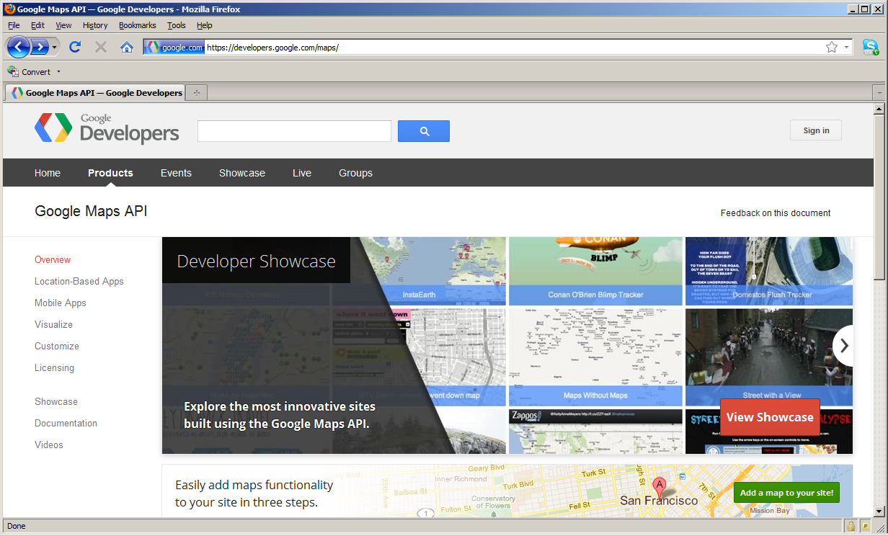
https://developers.google.com/maps/

Slide 9
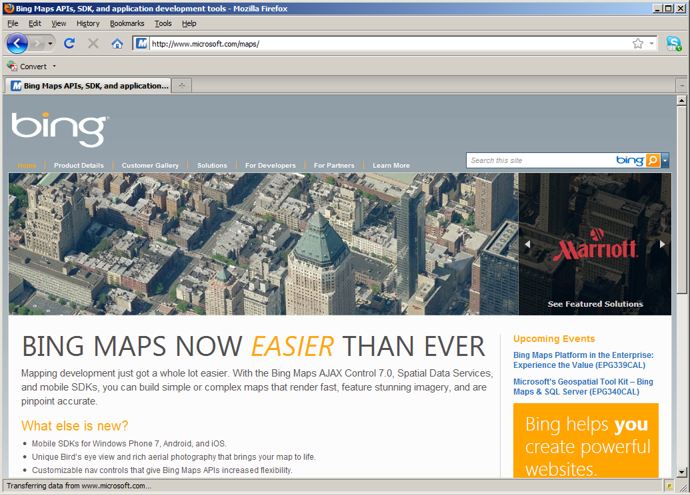
http://www.microsoft.com/maps/

Slide 10
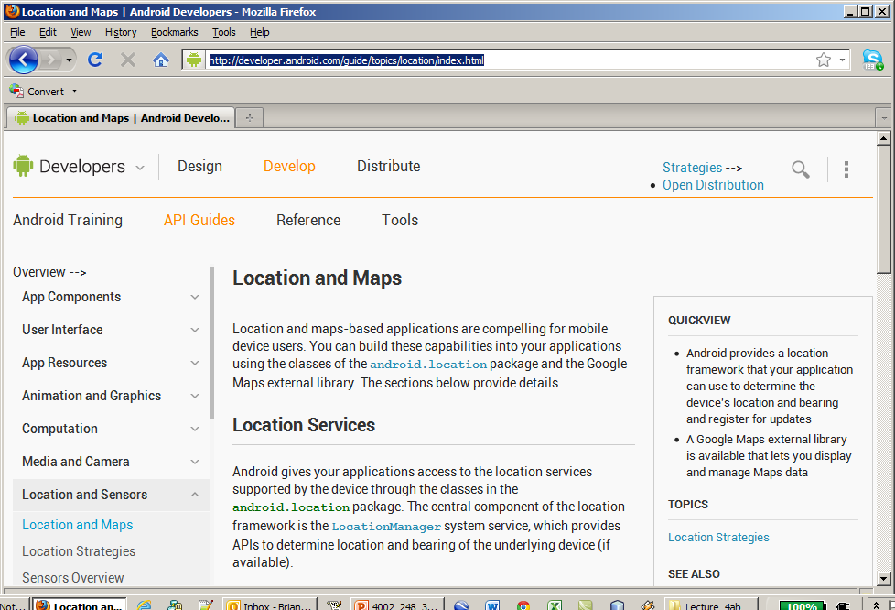
http://developer.android.com/guide/topics/location/index.html

Slide 11
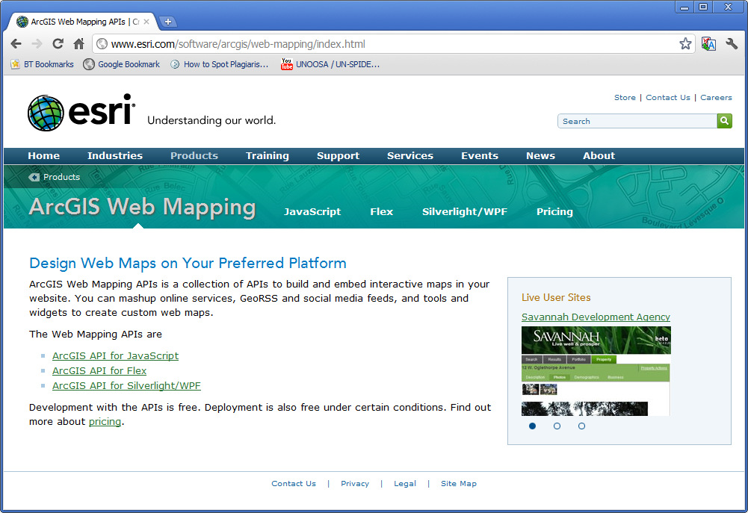
http://www.esri.com/software/arcgis/web-mapping/index.html

Slide 12
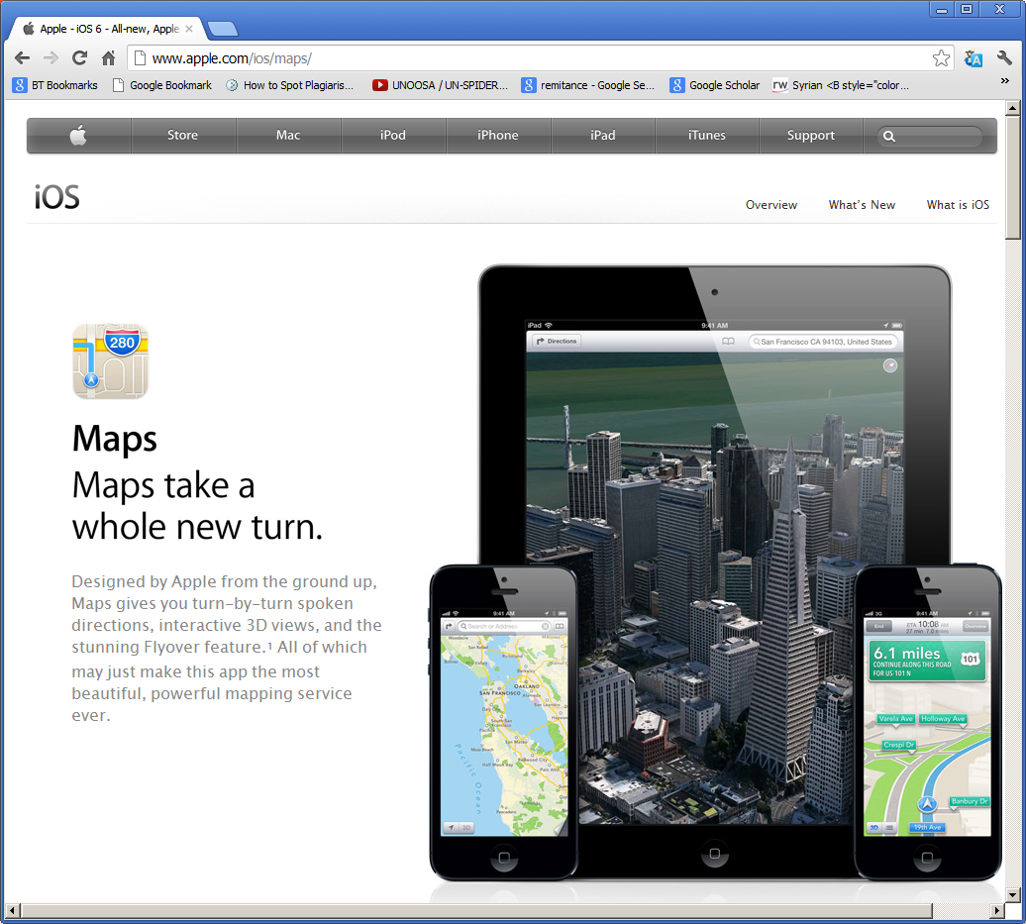
http://www.apple.com/ios/maps/

Slide 13
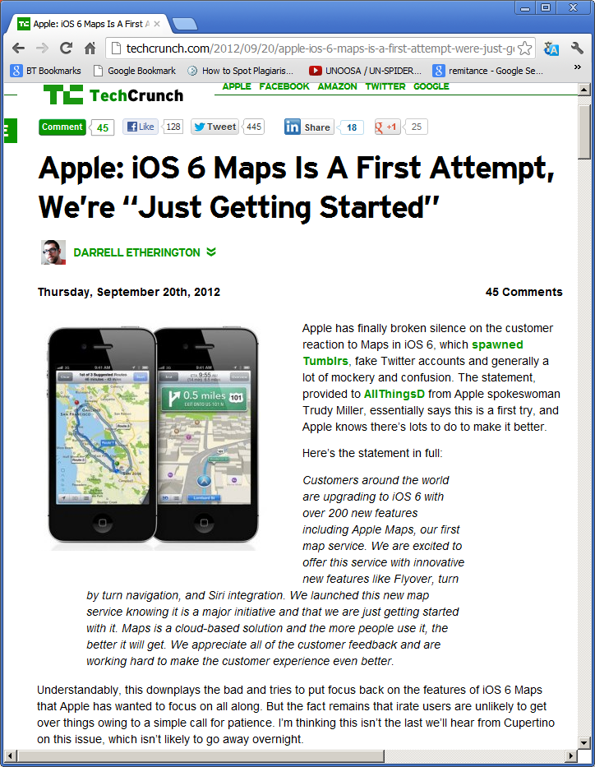

Slide 14
Open Source
Source Code Available
Community of developers add value
Examples – GeoServer, WorldWind

Slide 15
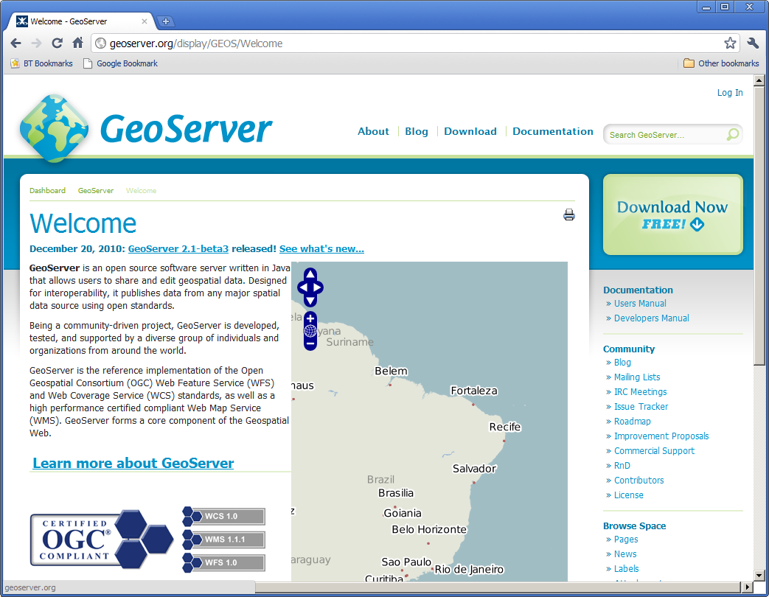
http://geoserver.org

Slide 16
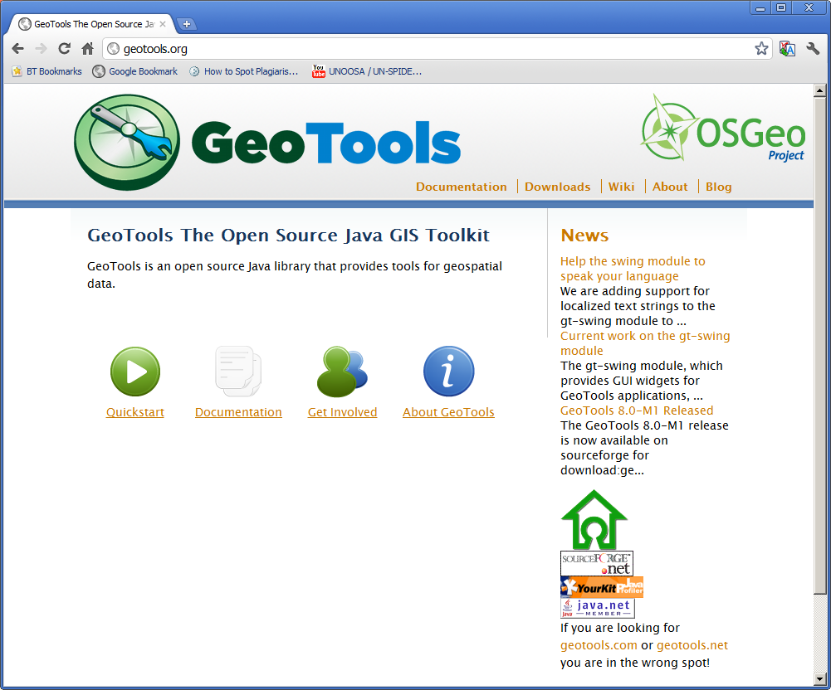
http://geotools.org/

Slide 17
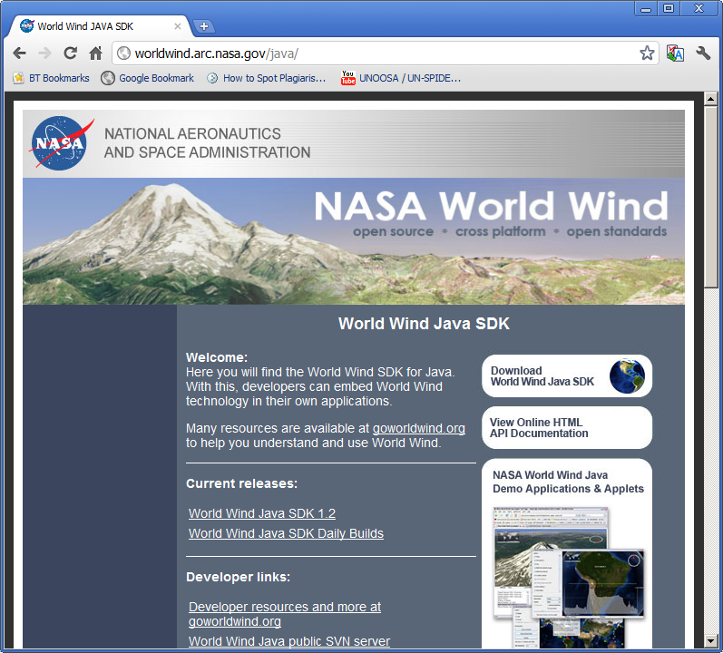
http://worldwind.arc.nasa.gov/java/

Slide 18
Open Standards
Open Geospatial Consortium (OGC)
Standards to allow mapping applications to “talk to each other”
New way to share all data type we talked about earlier in semester
Rooted in raster, vector GIS data models
XML based (in most cases)

Slide 19
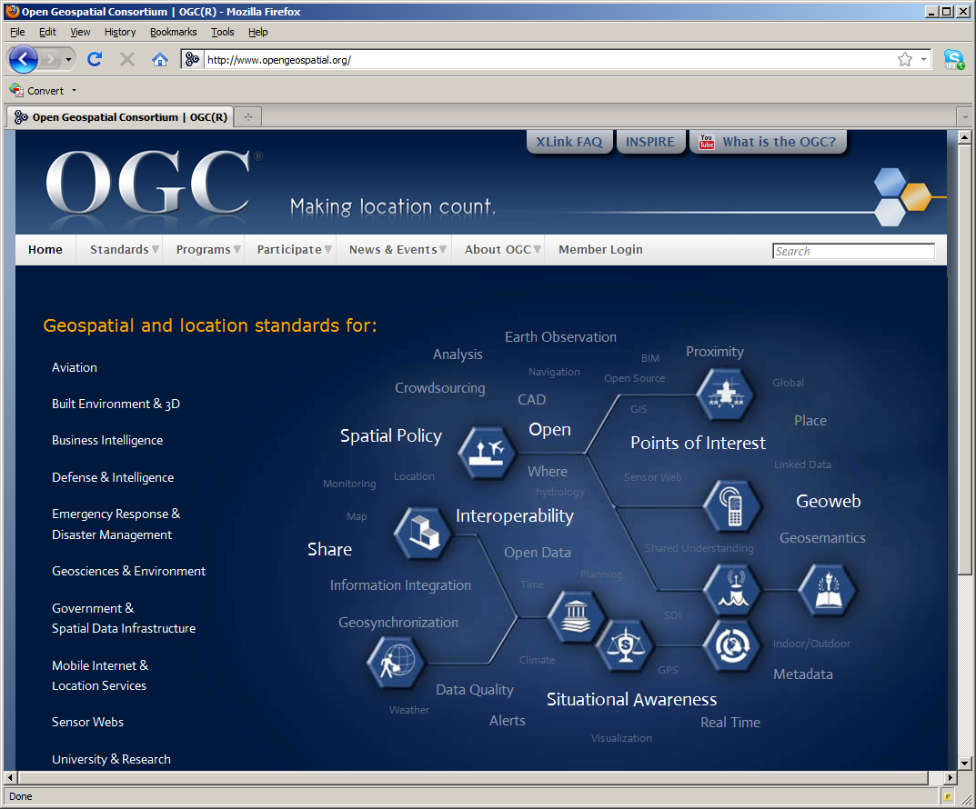
http://www.opengeospatial.org/

Slide 20
WMS
Web Map Services
XML based
Official OGC Standard
Defines protocols for sharing maps over the internet

Slide 21
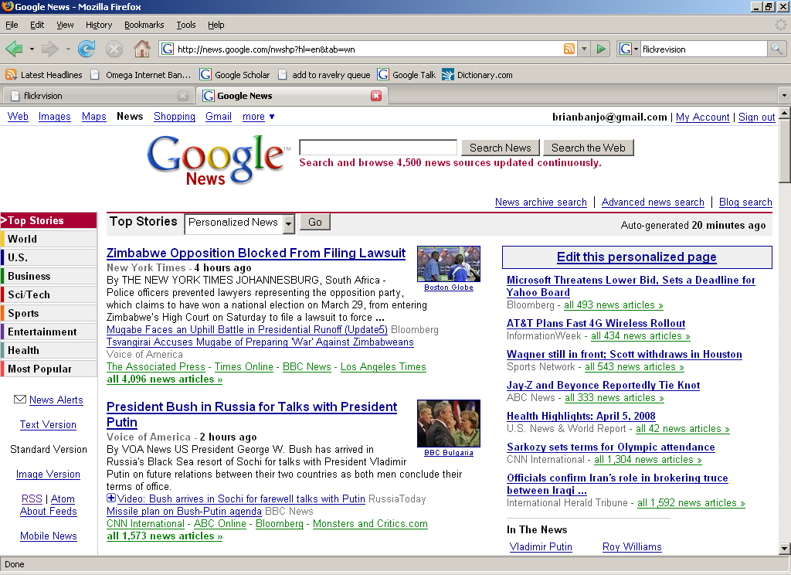
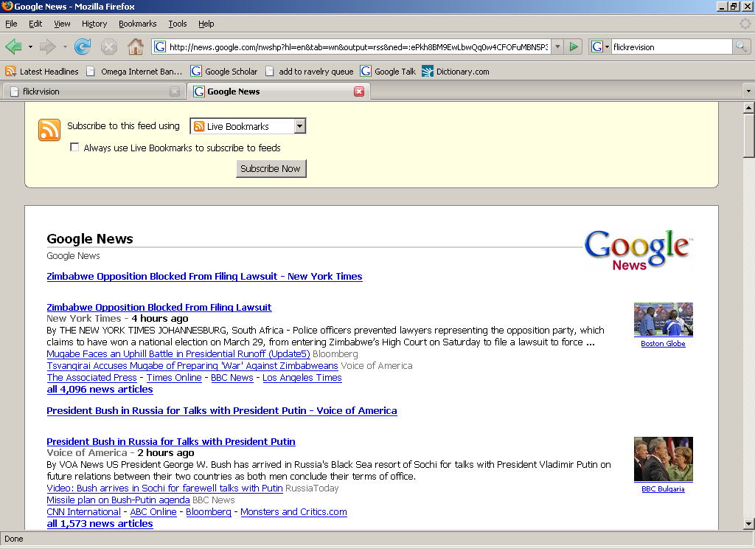
Closeup

Slide 22
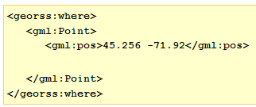
GeoRSS
GeoRSS – RSS with Geographic Component
GML – Geographic Markup Language
http://www2.monroecounty.gov/911/rss.php

Slide 23
Server-based Data Import URLs
https://viewer.nationalmap.gov/services/
WMS - https://basemap.nationalmap.gov/arcgis/services/USGSTopo/MapServer/WMSServer?request=GetCapabilities&service=WMS
ArcGIS Server- https://basemap.nationalmap.gov/arcgis/rest/services/USGSTopo/MapServer

Slide 24
ArcGIS JavaScript API
There have been many different viewer technologies and the latest is html5 and JavaScript which has replaced flex and silverlight
There are a few reasons
No plugins needed
Mobile friendly
Robust tools
Easily customizable

Slide 25
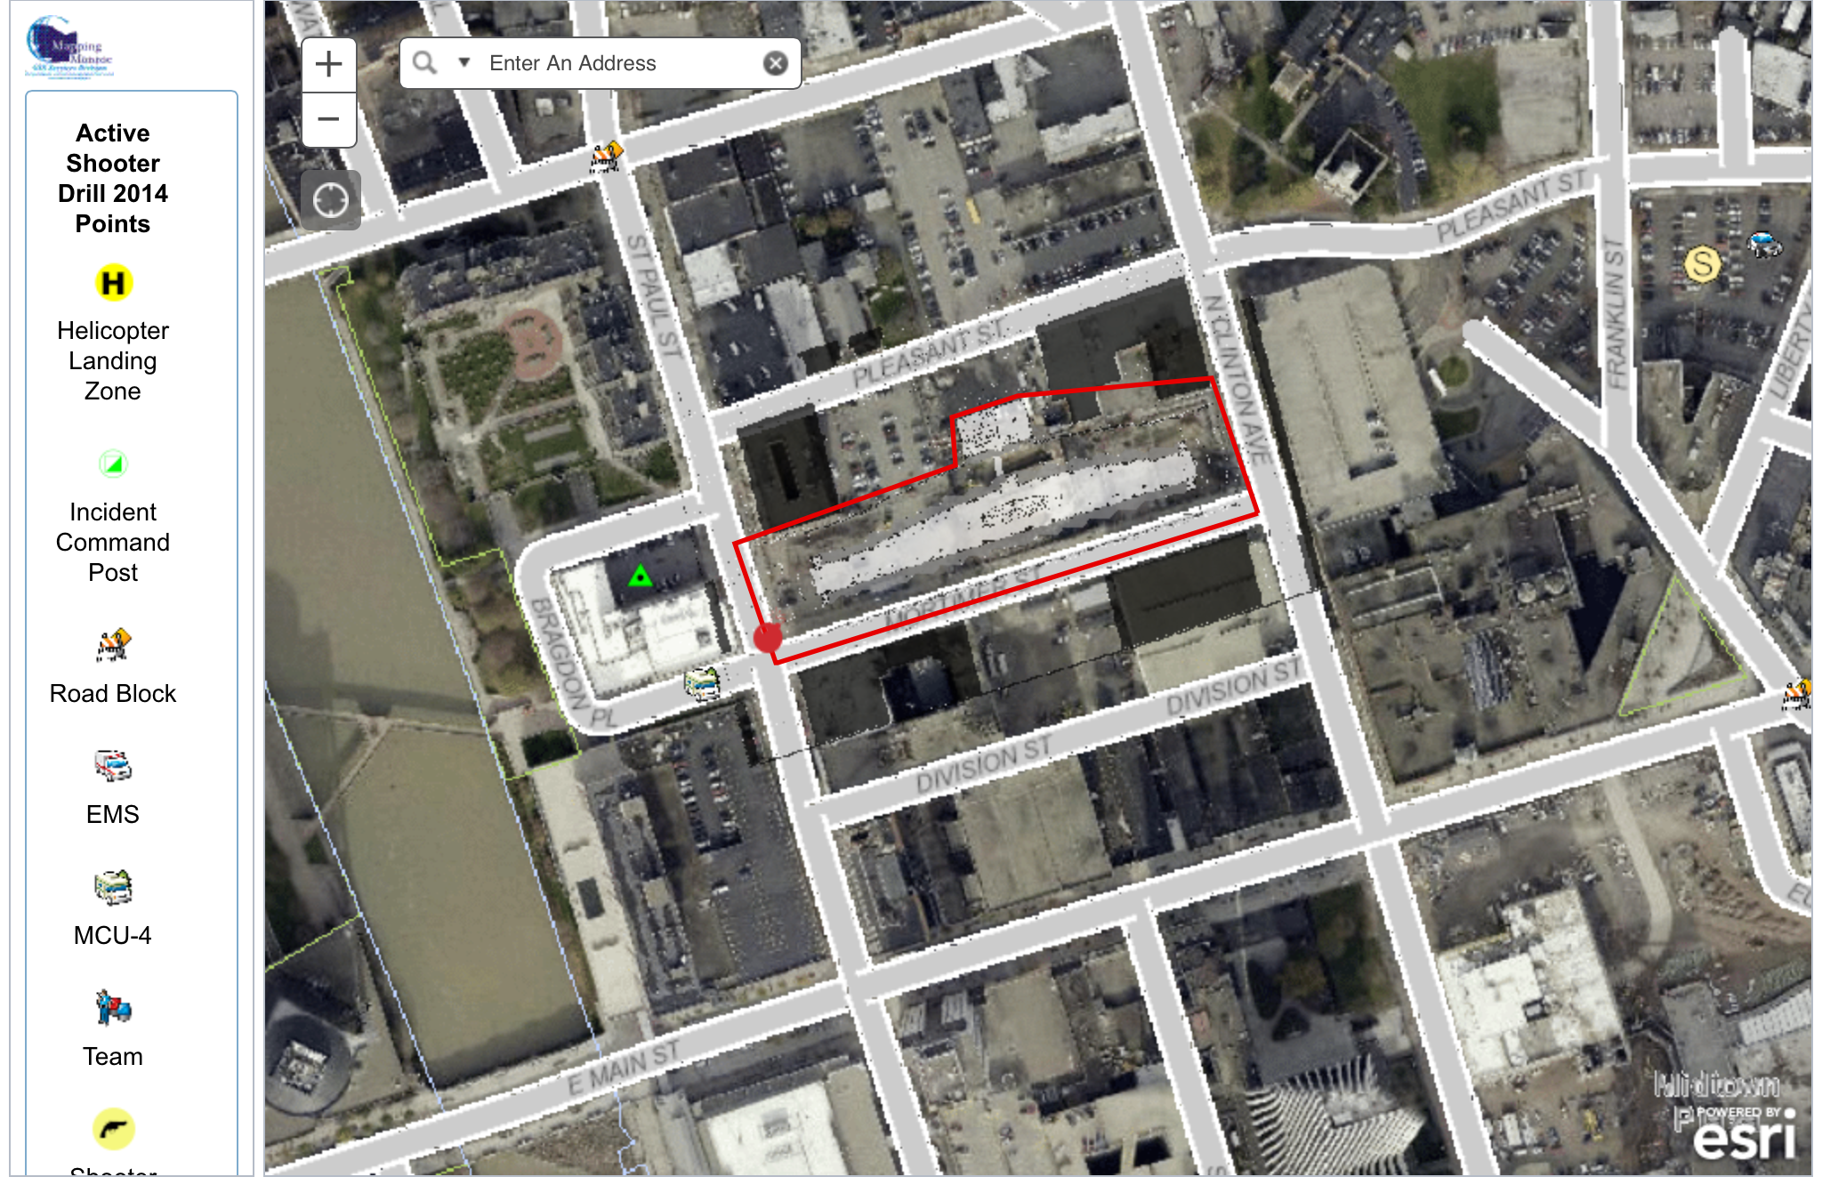

Slide 26
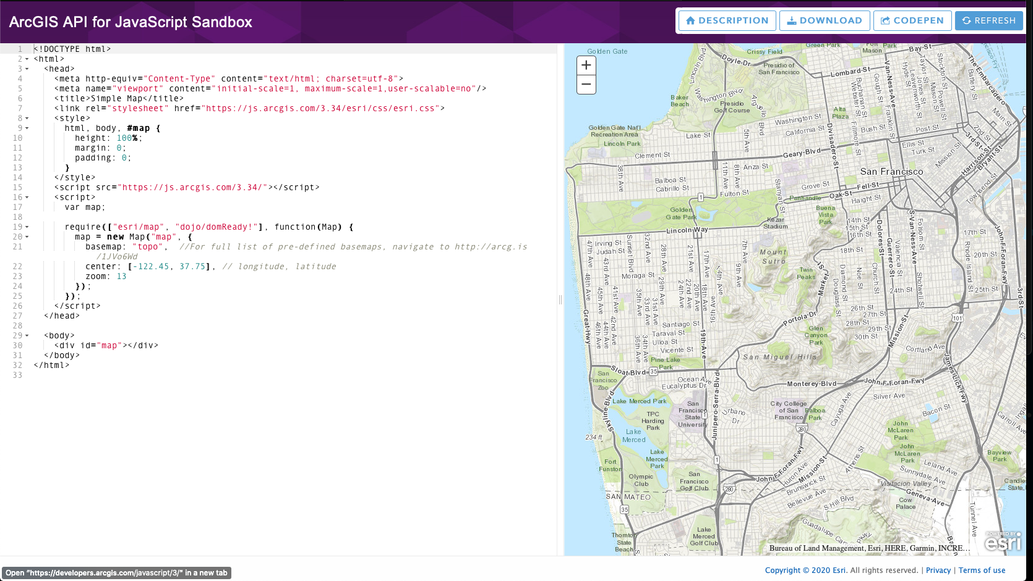
https://developers.arcgis.com/javascript/3/sandbox/sandbox.html

Slide 27
Hands on Activity
Using the JavaScript Sandbox we are going to make a basic web application.
https://developers.arcgis.com/javascript/jshelp/intro_firstmap_amd.html
After you create your first application we will use an ArcGIS Web Map as a base
https://developers.arcgis.com/javascript/jshelp/intro_agstemplate_amd.html

Slide 28
Using an ArcGIS WebMap
Build it in ArcGIS Online
In your application change webmapId = "1a40fa5cc1ab4569b79f45444d728067"; to your webmapID
To find the web map ID look at the URL
https://ritarcgis.maps.arcgis.com/home/webmap/viewer.html?webmap=a1c1954f39ce451c8d5711673c806f96

Slide 29
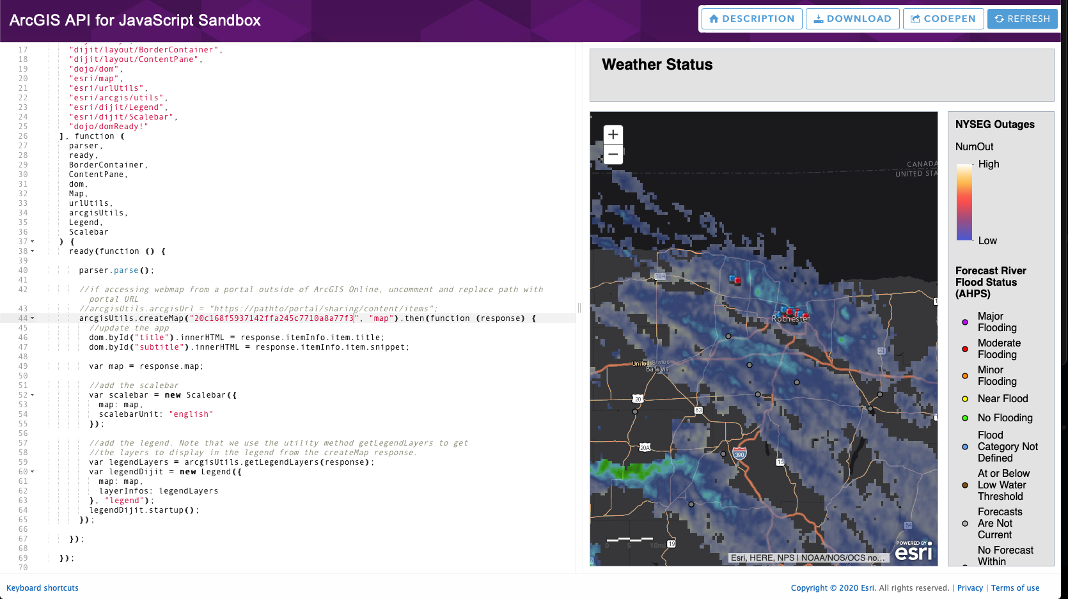

Slide 30
Using the Applications Outside Of Sandbx
Click Download or Copy the Code to a text editor
Change the extension to html
Copy to your web folder
type in url and see how it works

Slide 31
Discussion Assignment
Create a JavaScript Web Mapping Application using the esri JavaScript API and the sandbox.
I would suggest using the Webmap that you created for the hydrants because you already have it, but you can create a new one if you want.
Post a screenshot of your sandbox application

